Slide 1
FT TESTCASE GENERATION TOOL

Slide 2
Introduction
Architecture
Dataflow structure
Platform
Specification
The GUI must have some text box to input the project name
The GUI must have some dialog box to add the “rx_messages.xlsx” and “mapped_rx_signals.xlsx”
Mandatory information need to be collected in the “mapped_rx_signals.xlsx”
Mandatory information need to be collected in the “rx_messages.xlsx”
How to handle the signal name, message name and transmitter to match with database ?
How to handle the value of signal?
All mandatory precondition
Some special precondition for some project
GUI for special precondition
Set up the necessary speed
The GUI set up the values to enable and disable supported function

Slide 3
IDEA
1. INTRODUCTION
Reduce efforts when performing the function test
FT need full-fill all precondition before the testing, the tool will do that
Automatically creating the script to set up all the necessary speed value
Automatically creating the script to enable and disable all supported functions

Slide 4

2. ARCHITECTURE
DBC
export
Excel
The tool detect necessary informations in the excel
generate
.xml
DOORS
User collect information and input in the tool

Slide 5
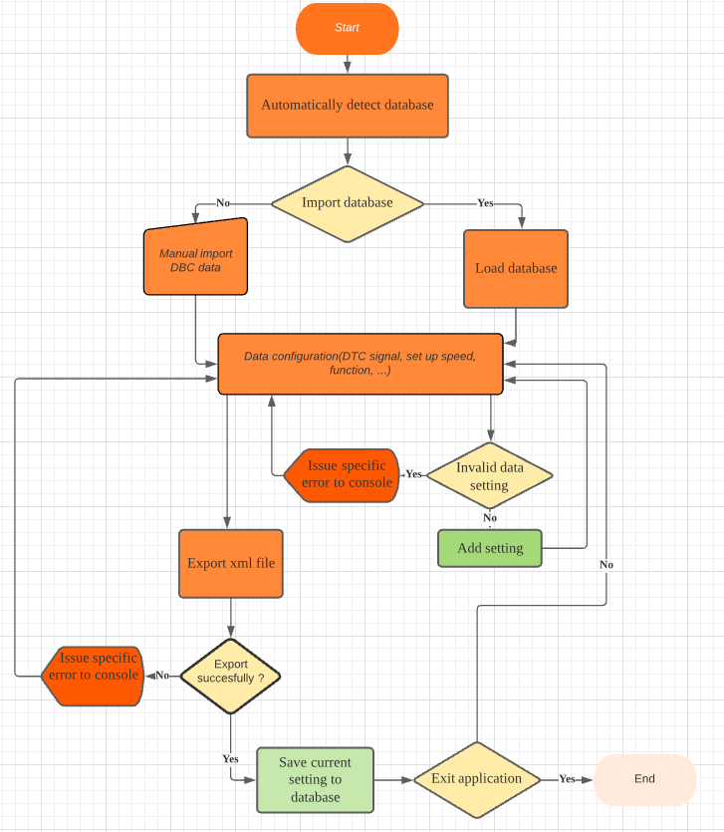
3. DATAFLOW STRUCTURE

Slide 6



4. PLATFORM

Slide 7
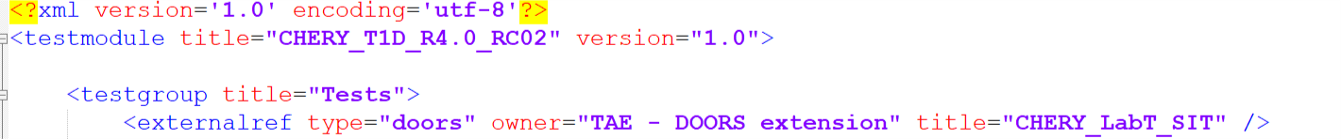
The GUI must have some text box to input the project name
5. SPECIFICATION
Project
CHERY
Variant
T1D
Release
R4.0
Version
RC02

Slide 8
The GUI must have some dialog box to add the “rx_messages.xlsx” and “mapped_rx_signals.xlsx”
5. SPECIFICATION
rx_message
../rx_messages.xlsx
Browse
mapped_rx_signals
../mapped_rx_signals.xlsx
Browse

Slide 9
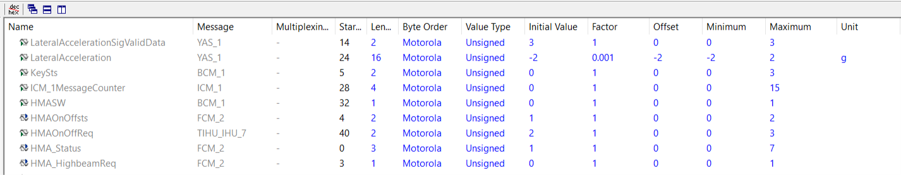
Mandatory information need to be collected in the “mapped_rx_signals.xlsx”
5. SPECIFICATION
Signal name
Message name
Initial value
Factor
Offset

Slide 10
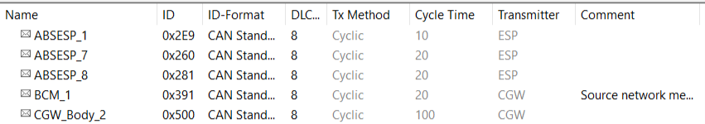
Mandatory information need to be collected in the “rx_messages.xlsx”
5. SPECIFICATION
Message name
ID
Transmitter

Slide 11
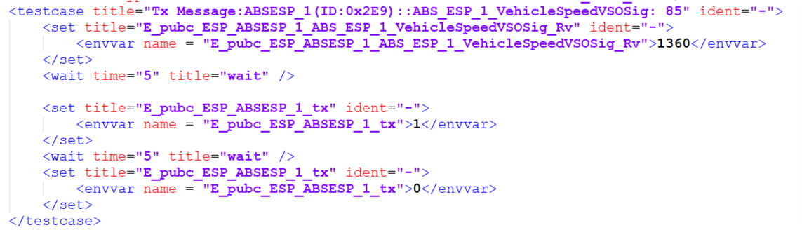
How to handle the signal name, message name and transmitter to match with database ?
5. SPECIFICATION
1
2
2
Tx value
E_pubc_[transmitter]_[message]_tx
1
Raw value
E_pubc_[transmitter]_[message]_[signal]_Rv

Slide 12
How to handle the value of signal?
5. SPECIFICATION
1
Physical value = 85 (Example) – By default, the tool will set the physical value automatically
Raw value = (Physical value – [offset])/[factor]
1

Slide 13





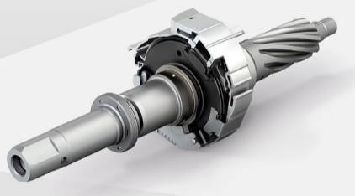
All mandatory precondition
5. SPECIFICATION
The tool must automatically detect all signals related to all precondition in DBC and set the specific values for those one.
Speed = 85 km/h
ECU Temperature = 23 ᵒC
All Vehicle Angle = 0
ABS = inactive
ESP = inactive
Torque ≥ 0

Slide 14


5. SPECIFICATION
Some special precondition for some project
User can collect the special precondition on DOORS and input in the Tool .The tool will create the respective precondition script.
Enable trigger DTC mode
Write the specific string to enable the function
The tool must provide the input boxs for all special precondition

Slide 15
5. SPECIFICATION
GUI for special precondition
Write the specific string to enable the function
Enable trigger DTC mode
Signal
Enable string
Raw Value

Slide 16

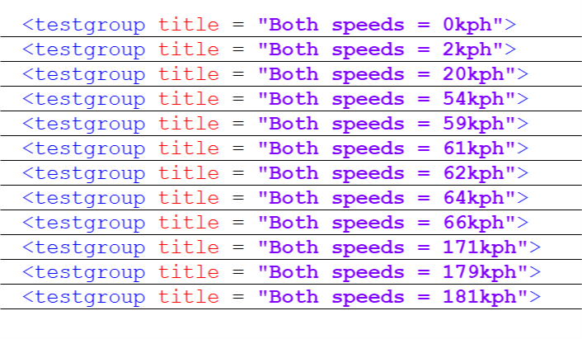
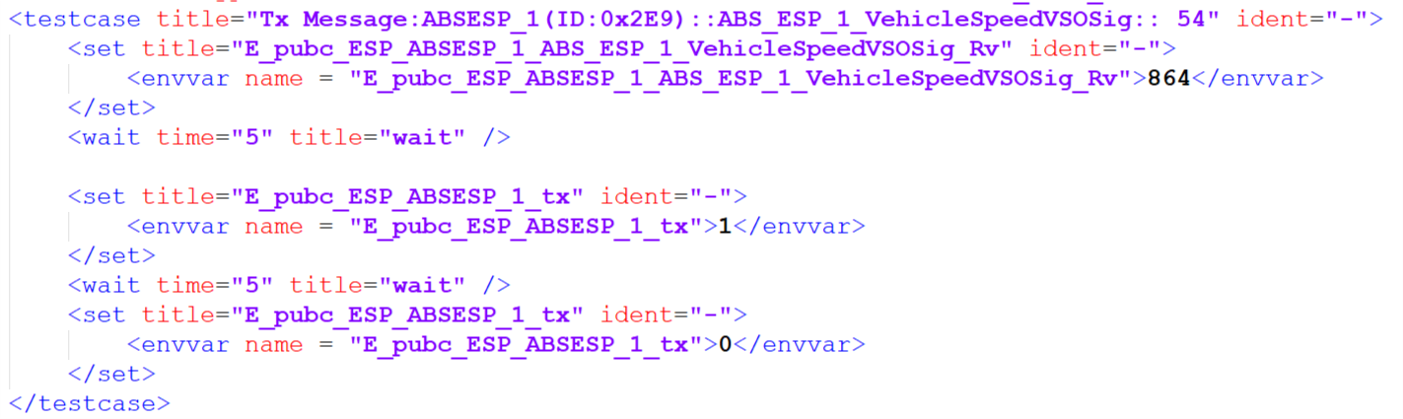
5. SPECIFICATION
Set up the necessary speed
Click the “Additional” icon, the new row will be created
Speed 1
20
Speed 2
54
1
User will fill the physical value in text box, the tool must convert this one to raw value and create the script related to speed.
Speed 3
62
1
1
2
This raw value should be converted from physical value by the formula

Slide 17



5. SPECIFICATION
The GUI set up the values to enable and disable supported function
CHOOSE THE SUPPORTED FUNCTIONS
LDW
Normal
Event
String
Signal
Enable value
Disable value
LDW
LKS
TJA
RDP
ELK
HMA
SLA
Click any supported function button, the respective pop-up with corresponding GUI will be showed. User can fill the necessary information in this GUI for each function.
To store all parameters in a Excel template
Save

Slide 18
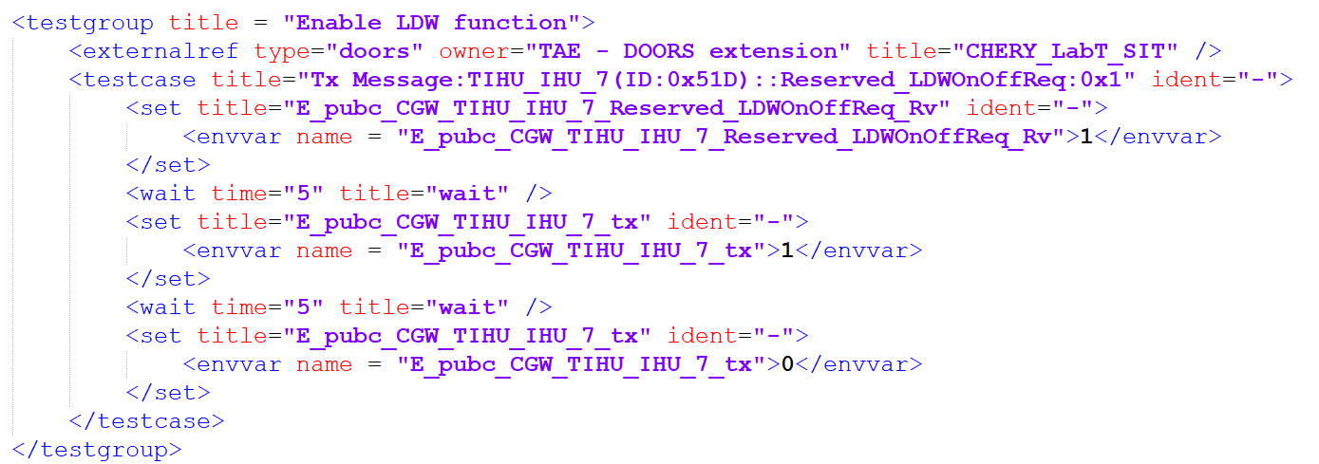
5. SPECIFICATION
The GUI set up the values to enable and disable supported function
There are 5 scenarios to enable or disable the function.
Set up a specific value for the respective signal.
Create a event button for the respective signal.
Write a string by service 2E
Combine 3&1
Combine 3&2
There are 3 modes (3 checkboxs)
Normal
Event
String
Normal
Event
String
Signal
Reverved_LDWOnOffReq
Enable value
1
Disable value
0

Slide 19
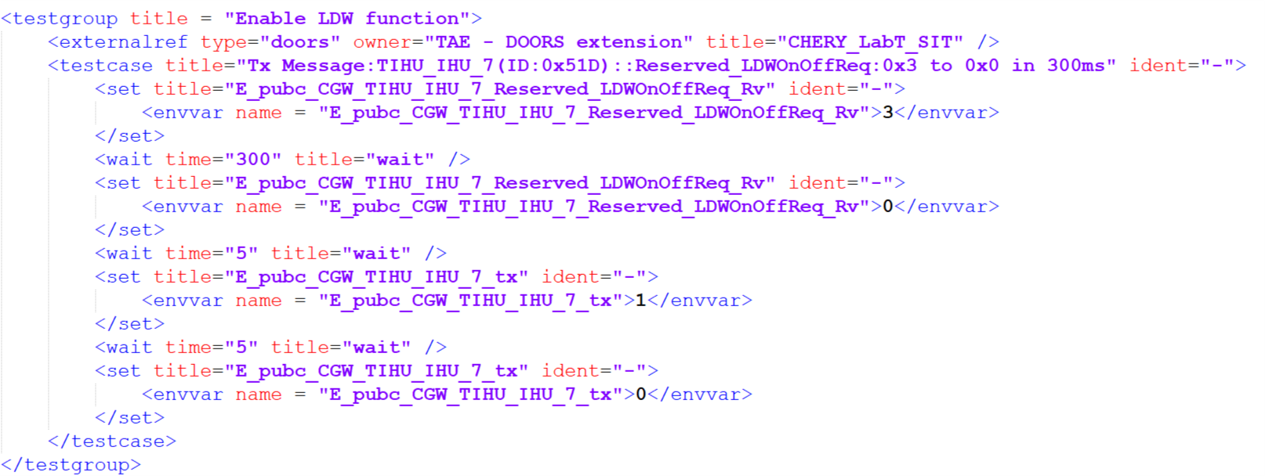
5. SPECIFICATION
The GUI set up the values to enable and disable supported function
There are 5 scenarios to enable or disable the function.
Set up a specific value for the respective signal.
Create a event button for the respective signal.
Write a string by service 2E
Combine 3&1
Combine 3&2
There are 3 modes (3 check boxs)
Normal
Event
String
Normal
Event
String
Signal
Reverved_LDWOnOffReq
High level
3
Low level
0
Press counter
1
Enable duration
300
Disable duration
300

Slide 20
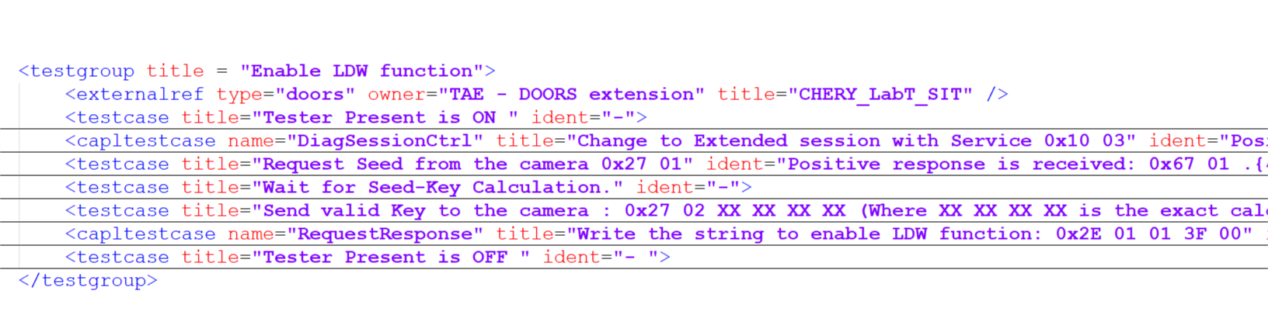
5. SPECIFICATION
The GUI set up the values to enable and disable supported function
There are 5 scenarios to enable or disable the function.
Set up a specific value for the respective signal.
Create a event button for the respective signal.
Write a string by service 2E
Combine 3&1
Combine 3&2
There are 3 modes (3 check boxs)
Normal
Event
String
Normal
Event
String
Signal
Reverved_LDWOnOffReq
Enable string
2e01013f00
Disable string
2e01010000

Slide 21
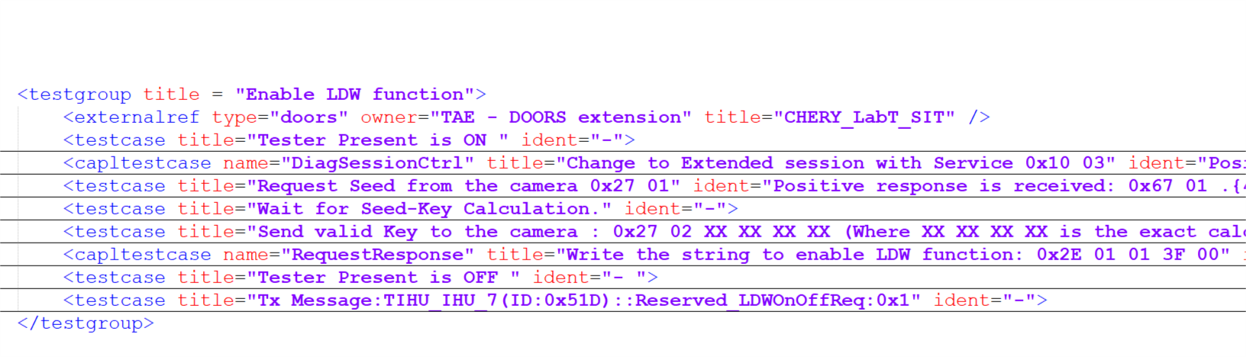
5. SPECIFICATION
The GUI set up the values to enable and disable supported function
There are 5 scenarios to enable or disable the function.
Set up a specific value for the respective signal.
Create a event button for the respective signal.
Write a string by service 2E
Combine 3&1
Combine 3&2
There are 3 modes (3 check boxs)
Normal
Event
String
Normal
Event
String
Signal
Reverved_LDWOnOffReq
Enable string
2e01013f00
Disable string
2e01010000
Enable value
1
Disable value
0

Slide 22
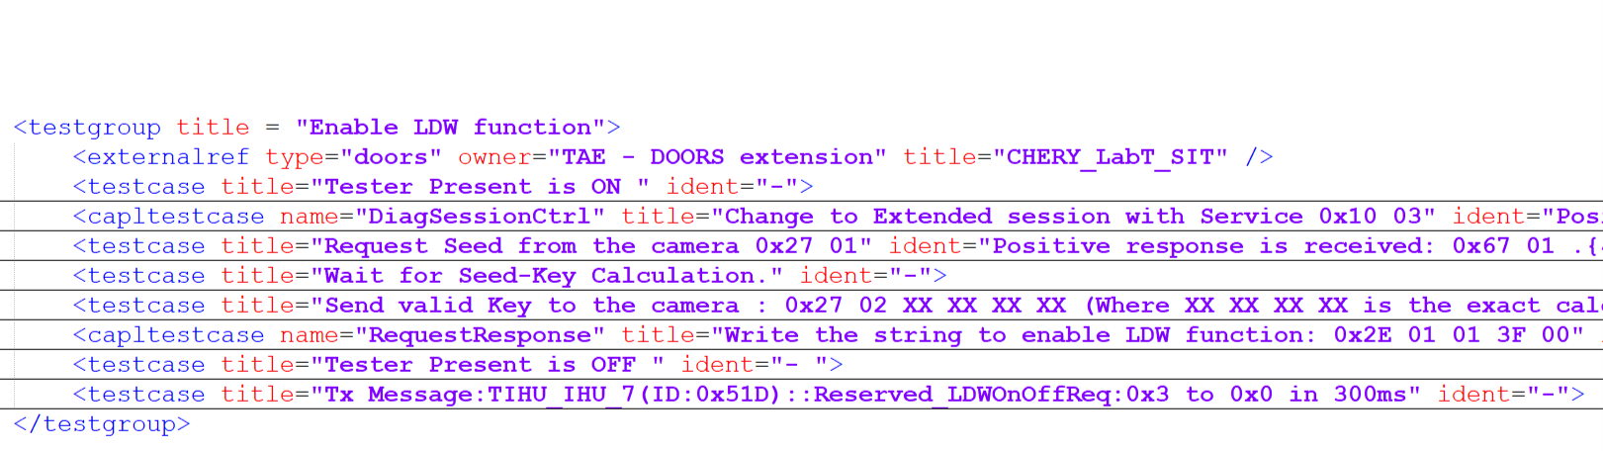
5. SPECIFICATION
The GUI set up the values to enable and disable supported function
There are 5 scenarios to enable or disable the function.
Set up a specific value for the respective signal.
Create a event button for the respective signal.
Write a string by service 2E
Combine 3&1
Combine 3&2
There are 3 modes (3 check boxs)
Normal
Event
String
Normal
Event
String
Signal
Reverved_LDWOnOffReq
Enable string
2e01013f00
Disable string
2e01010000
High level
3
Low level
0
Press counter
1
Enable duration
300
Disable duration
300

Slide 23
The end

